Slide 1
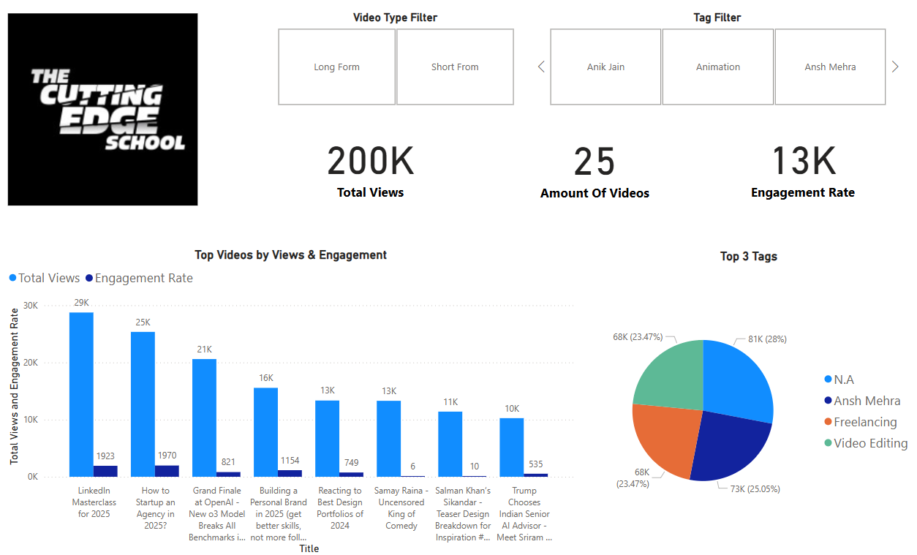
The Cutting Edge School YT data report
From 17th Dec To 17th Jan
-By Darren Pereira

Slide 2
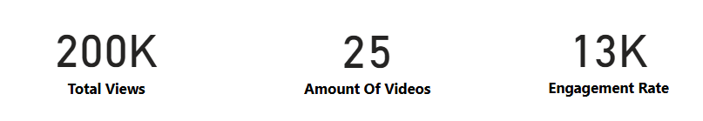
Data report key points
1.) Total views, engagement and videos
21(short form) + 4(long form) videos
Data from the 17th of Dec to 17th of Jan
58% of the total views came from short form content and nearly an equal split for engagement rate between the two forms with 52% for short form.
Only 4 long form videos were able to match the short form in engagement rate clearly showing scope of improvement engagement wise in short form.

Slide 3
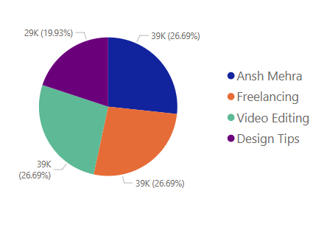
Data report key points
2.) Most popular tag/categories for videos
Used the tags mentioned for the video to figure out the category.
Ansh Mehra is still amidst the top most tags for the channel tied with Freelancing and video editing all individually contributing to 26.69% of the total views.
The content during this period was about ai, design, freelancing and infotainment videos but design and freelancing resonated the most with the audience since the two amounted to about 46% of the total views.

Slide 4
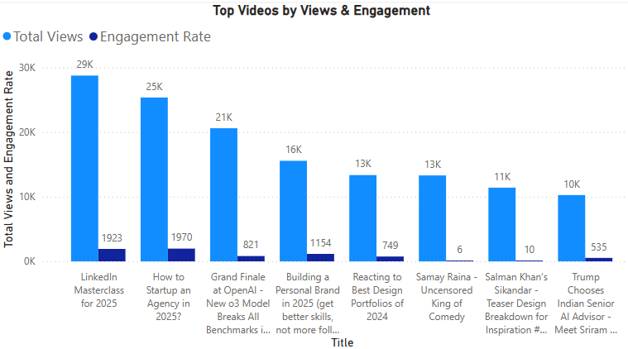
Data report key points
3.) Top videos of this period
‘LinkedIn Masterclass’ generated the most views and engagement for the long form segment.
Whereas ‘Grand Finale at Open AI’ generated the most views and engagement for the short form segment.
The video ‘How to startup an agency’ wasn’t far off as it was the second most viewed video and in fact got a similar engagement rate in shorter span of time, to the top video hence there was no doubt it would soon have more views than ‘LinkedIn Masterclass’.

Slide 5
Suggestions
1.) Add a CTA to the short form or plugin your long form video
The short form content has scope to improve in the engagement rate, I suggest simply at end of the video to say ‘like and comment this reel’ or have people to comment a specific word according to the theme to receive a freebie it could be an old video of yours or a list of hacks your audience can benefit from, in the form of the reply in the comments.
If this doesn’t work , we know that shorts are easier to watch by the audience as they are hardly 60 seconds, we use it to our advantage by plugging in the long form video related to the topic of the short since there is a high chance the audience will enjoy the long form related to that short.

Slide 6
Suggestions
2.) Make videos on niche specific topics short form
The two videos that got most views is LinkedIn masterclass and startup agency. What’s common between the two is that both can be watched by anyone unlike the video which you recently released UI/UX case study which can be watched by people who only know how to use Figma properly.
Hence my suggestion is that if you are making a video which targets a specific segment of that niche , I recommend you to make it in short form since it is very bite sized and easily consumed by the audience, even those who are not form that targeted segment while doom scrolling. If the viewer what's to go in depth you could list a few articles, attach fellow creators or your old videos in the description.

Slide 7
To see how I got the data move the next slide

Slide 8
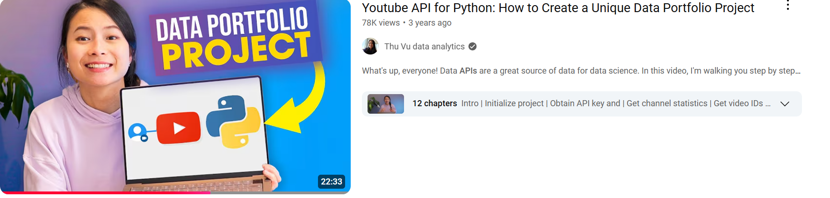
How I got the Data??
Used the google developers Api for YouTube Data, to fetch the channel’s data like like count , view count , duration , upload date.
Also, I followed this YouTube video below since it was my first time using the Api but the final analysis of the data was done by me 😉

Slide 9
The process:
Making a google developer account to access the api and creating a python virtual environment to execute the api was the foremost step.
Importing python packages like
1.) pandas: for converting our data in a tabular format and exporting that to excel
2.) build from googleapiclient.discovery: to acces the various inbuilt functions of the api
3.) JSON from IPython.display: To convert the intital outputs which are in simple text to a more readable and functional output.

Slide 10
The strategy:
To extract the data from the videos first we must locate those videos but those videos are in a playlist.
Here’s the catch even if the videos are not actually put in a specific playlist by the creator.
The api has a master playlist with all the videos in it of the channel and to access that we first need to get the channel id.
Channel id -> Playlist id -> Video id
Within the channel id there is the playlist id and inside that we have the video id. So first we need to find the playlist id since the channel id can be found using simply a ctrl+f in the page source of that channel

Slide 11
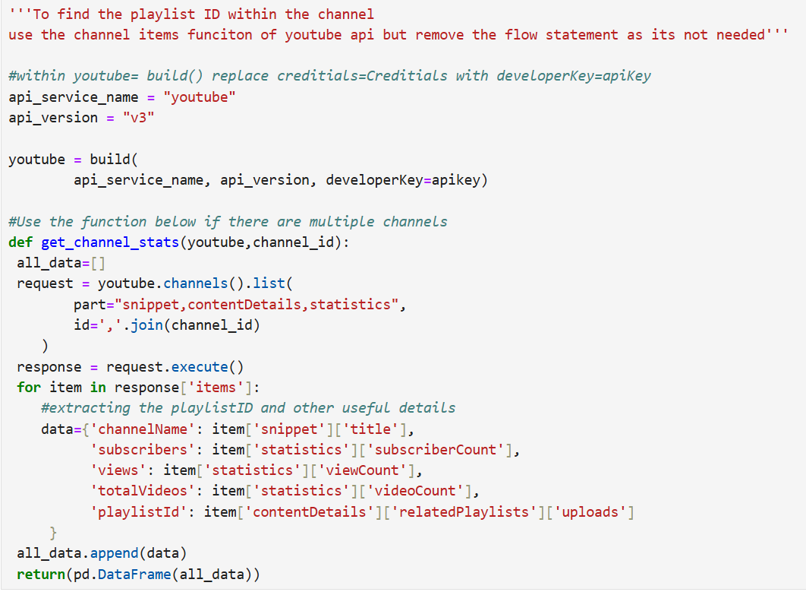
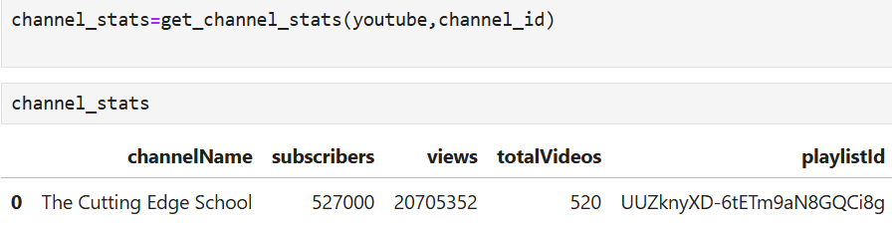
Extracting the Playlist ID
Code:
Output:

Slide 12
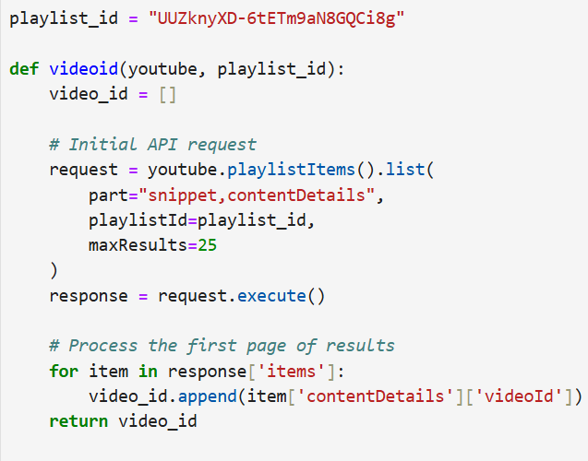
Extracting the Video ID’s in the last 1 month
Code:

Slide 13
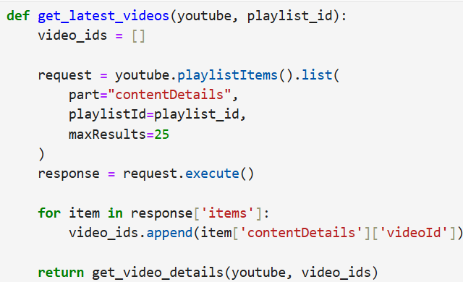
Extracting the Details from videos we scraped
Code:
For this we will be using two functions, the next one is on the next page

Slide 14
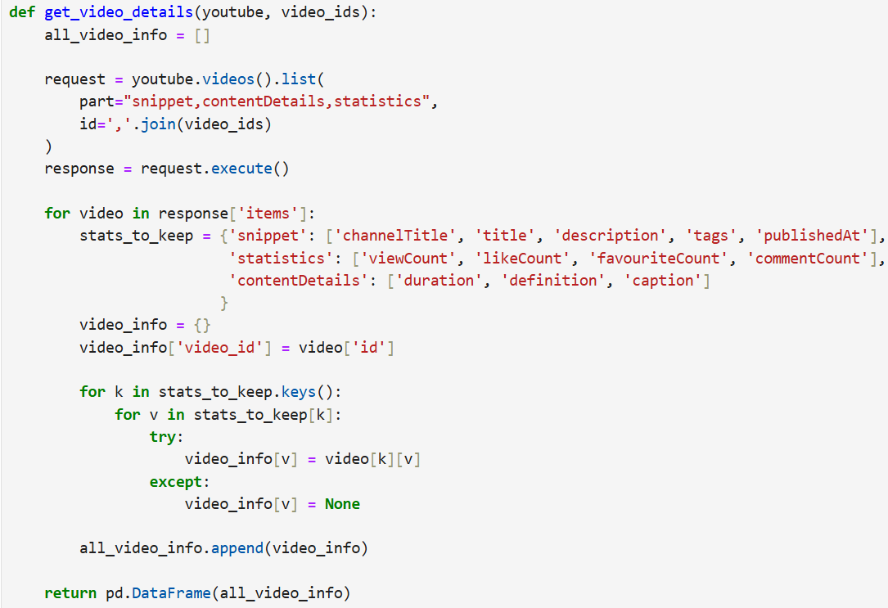
Extracting the Details from videos we scraped
Code:

Slide 15
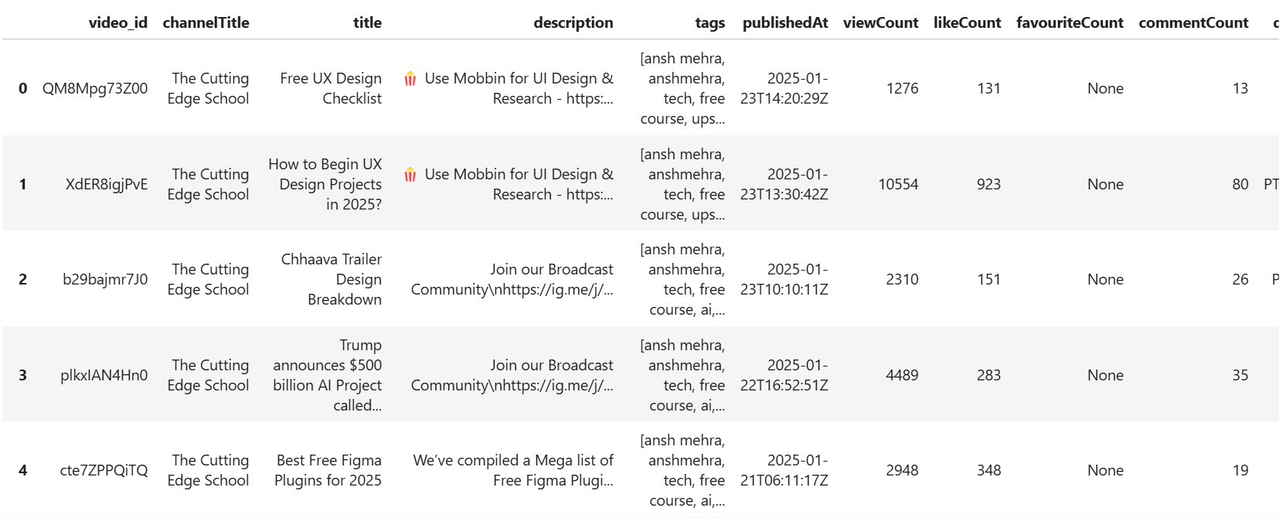
Final Output

Slide 16
Cleaning the data
1.)Removing unnecessary columns like caption and video quality since it had the same values for every row i.e. HD
2.)In the previous slide in the tags section you can see that all the tags of a video are in a list like [‘Ansh Mehra’, ‘ui’ ,’ux’, ‘freelance’]
This makes the data harder to analyze hence I loaded the data to power bi and grouped all the tags by the number of times they appeared in the whole dataset and connected that table to the original table.
3.)Changed format of duration column in power bi to make it more readable and added a column classifying the video as short or long form

Slide 17
Thank You
PPT and report by Darren Pereira
My LinkedIn profile
https://www.linkedin.com/in/darenpereira/
My GitHub profile
https://github.com/DarrnP?tab=repositories

